Slide 1

Case Study on Leak Detection in Water-supply network using Ground Microphone Methodology
A Case Study by Kerala Water Authority
Presented by: R. GIRIJA, IAS. MISSION DIRECTOR, AMRUT Kerala
1

Slide 2
SUMMARY
A Case Study by Kerala Water Authority
Generally water supply mains are laid underneath of roads – Concrete/Bituminous surfaces.
The leakages on underground pipes below the roads are precipitated in a different location due to sealed surfaces.
Conventional method of open excavation for finding leak points leads to wasteful expenditure of resources.
Here comes, a solution to find out the exact leak location using the Ground Microphone Methodology.
2

Slide 3
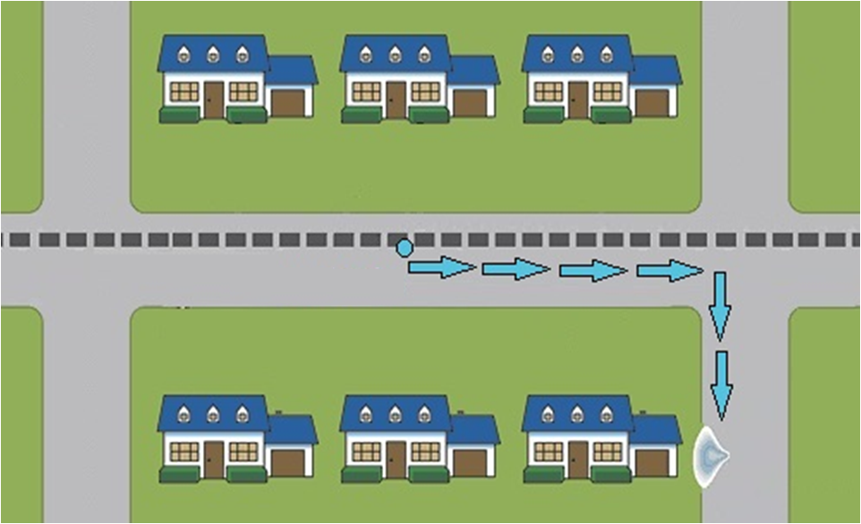
THE ISSUE
A Case Study by Kerala Water Authority
Water Supply Main
Water Supply Main
Original Leak Point
Actual
Leak Precipitation Point
Leak Precipitation Point
3

Slide 4
THE ISSUE
A Case Study by Kerala Water Authority
A water supply transmission main of 355mm dia PVC along main road (Fully Bituminous road) at Kozhikode City, Kerala.
Considerable pressure drop observed in the line.
Water leakage inferred in the main road a stretch of one km (between Ramanattukkara and Faroke)
Water seepage observed in a by-road, near to the main road
No pipelines in the by-road. Suspected that, leakage originated from the main pipeline.
Difficult to trace the leakage point, because:
    A 30m distance between By-road and Main road.
    About 2m level difference between two roads.
    The suspected road was BMBC topped recently.
4

Slide 5
THE METHODOLOGY
A Case Study by Kerala Water Authority
Device – Ground Microphone (an acoustic leak detecting equipment)
Device Components :
  A microphone with casing
  An amplifier with filtering mechanism, digital display and control buttons
  A high quality headphone
It amplifies the following sounds generated from a leak:
  Jetting Sound
  Water flowing sounds within the soil cavity
  Sound of Jet hitting the soil
  Sound of soil particles hitting the pipe
  Sound of soil particles hitting themselves
5

Slide 6
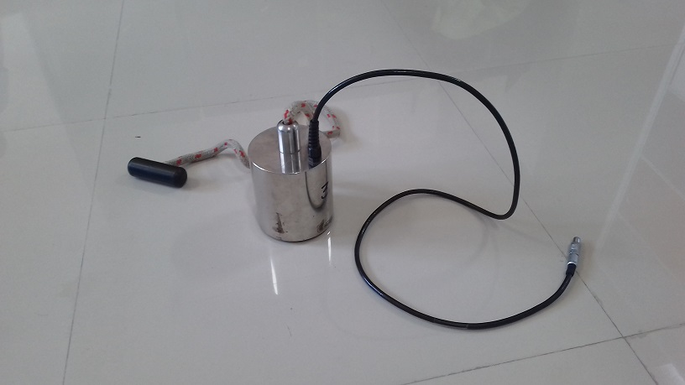
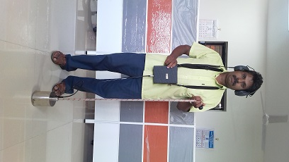
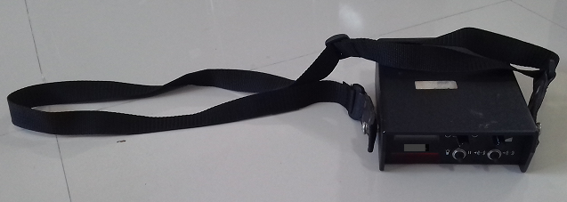
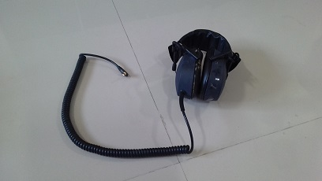
A Case Study by Kerala Water Authority
Ground Microphone
Test Setup
Amplifier
Headphone
6

Slide 7
THE ANALYSIS
A Case Study by Kerala Water Authority
The technique involves positioning the microphone on the ground at intervals along the line of the pipe and noting changes in sound amplification as the microphone nears the leak position.
The accuracy and the time to identify the leak point, highly depends on the detection skills of the personnel. Hence, strong analytical skills and sharp judgement skills are extremely important.
An experienced expert can distinguish water leakage sound from other background disturbances and environmental noises by correlating his past experiences with the present situation.
7

Slide 8
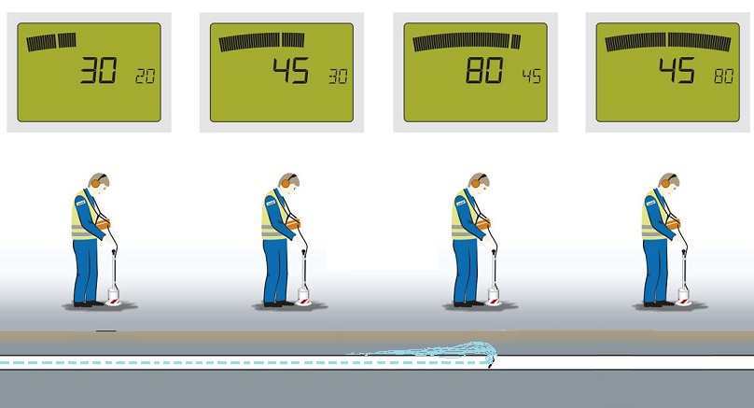
WATER LEAK PINPOINTING
A Case Study by Kerala Water Authority
8

Slide 9
THE SOLUTION
A Case Study by Kerala Water Authority
Selected 300m around the suspected area for the survey.
Identified the alignment of the pipeline.
Survey carried out along the alignment with strides of 15cm to 30cm.
Clear howling sound start hearing from a particular location.
Point confirmed by rescanning a stretch of 5m both upstream and downstream direction of flow.
The point exposed, leak found at the exact point identified in the survey.
The leak rectified and pressure in the pipeline restored.
9

Slide 10
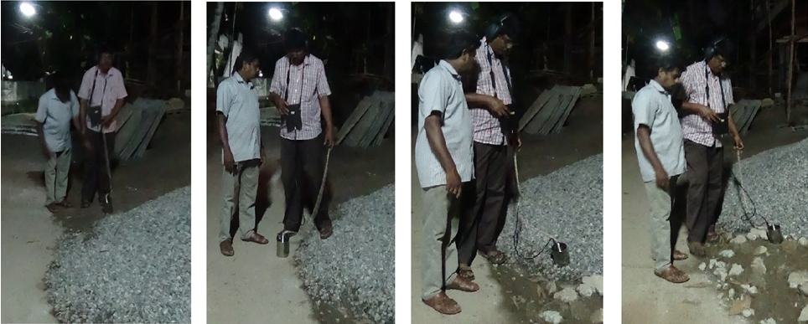
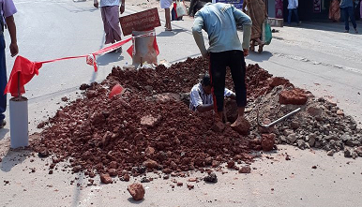
10

Slide 11
BENEFITS
A Case Study by Kerala Water Authority
Improved operational efficiency.
Lowered operational costs in terms of time, labour and other resources.
Extended life of road toppings
Reduced possibility of damaging other utilities.
Reduced potential for contamination and improved efficiency.
Limited inconvenience to the public.
Improved public relations.
11

Slide 12
LIMITATIONS
A Case Study by Kerala Water Authority
Background noise can interfere with leak sounds.
Pressure must be high enough for the leak to produce a sound.
Leak point confirmation is sometimes only possible at night.
Takes years of experience to develop a audition skill for pinpointing leaks.
12

Slide 13
Thank You
- Amrut kerala
13

