Slide 1
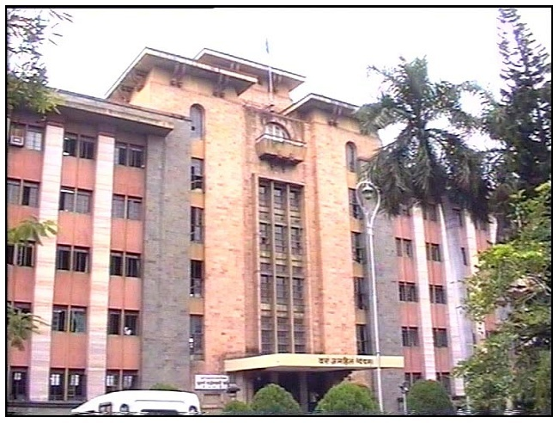

Pune Municipal Corporation –
Municipal Bonds
CMA Ulka Kalaskar
Chief Accounts & Finance Officer
Pune Municipal Corporation
Pictograms • Pictograms

Slide 2
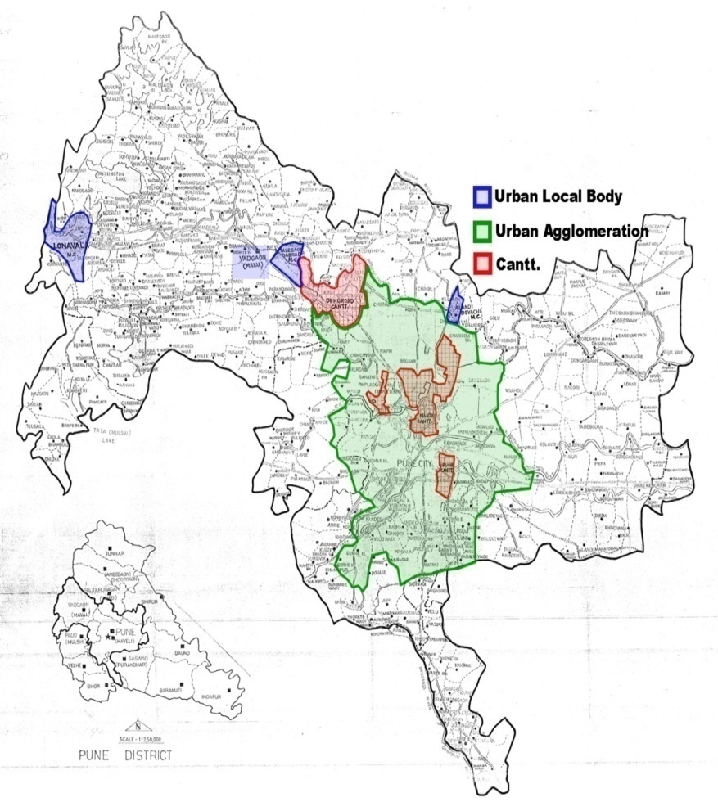
Pune City - Snapshot
8th – Most populous city of India
324sq. km – Area under PMC (recently 11 villages has been merged)
4 million – Population of PMC
46,17,773 – Vehicles registered²
500–600 per day – New cars registered
69 billion USD– GDP of Pune city (5th highest in country)

Slide 3







Pune City - Strengths
Economic strength
Presence of top IT/ITES companies – 2nd Largest center for IT / ITES exports in 2015
Strong manufacturing base across auto and engineering
One of the top 5 destinations for Foreign Direct Investment
Successful startup destination with more than 400 start ups
With three rivers in the city, potential for developing as a riverfront city
Strong human capital
811 colleges – “ Oxford of the East”
Graduate workforce >30% ideal for IT/ ITES and high technology sectors
Cultural and natural strengths
Center of the Maratha Empire in the 18th century
Cultural capital of Maharashtra
3

Slide 4
Municipal Bonds In India
What is Municipal Bonds?
Municipal bonds are bonds issued by urban local bodies- municipal bodies and municipal corporations (entities owned by municipal bodies) to raise money for financing specific infrastructure projects.
These bonds are attracting attention as the ULBs urgently need money to finance infrastructural expenditure. Especially for smart cities and other urban development projects.
In 2015, SEBI made fresh guidelines for the issue of municipal bonds for enabling the ULBs to mobilize money.

Slide 5
PMC Credit Rating
Pune Municipal Corporation :- Dual rating done for FY 2017-18 & 2018-19
India Ratings and Research (Ind-Ra) has affirmed Pune Municipal Corporation’s (PMC) Long-Term Issuer Rating at ‘IND AA+’. The Outlook is Stable.
CARE assigns AA+ rating to Pune Municipal Corporation’s (PMC) with stable Outlook.

Slide 6
PMC Credit Rating – Key rating drivers(1/2)
Higher own revenue sources credit positive
Consistent Revenue Surplus
Comfortable debt & liquidity position
The proportion of PMC’s own revenue in the total revenue income averaged 87.57% during FY12-FY17. The share of grants in the total revenue income remained consistently below 10% during the period. Property, water and local body tax collections were the key drivers of tax collections during the period.
PMC’s financial performance was robust during FY12-FY17, indicated by consistent revenue surplus. Its operating ratio (revenue expenditure/revenue income) remained in the range of 0.50x-0.70x during the period. Its operating revenue surplus was 25%-48% of the operating revenue income during FY12-FY17
PMC’s debt payment/total revenue was 0.26% in FY17 (FY16: 0.37%), indicating the comfortable credit profile of the corporation. Its debt service coverage ratio declined to 9.81x in FY17 from 47.98x in FY16 due to the pre-payment of loans.

Slide 7
PMC Credit Rating – Key rating drivers(2/2)
Water supply project
The key objective of the project is to provide safe and equitable 24×7 metered water to the entire city. PMC has utilized INR41.27 million of the bond proceeds so far and invested the remaining proceeds in a fixed deposit. The construction of reservoirs component of the project, which is underway, is being funded through Atal Mission for Rejuvenation and Urban Transformation grants. The balance amount from the bond proceeds will be used to fund the pipeline and metering works, which are likely to commence from November 2018. PMC targets to complete the water supply project by the end of 2022.
Adherence to servicing mechanism
PMC has a structured payment mechanism in place for the timely servicing of both interest and principal. The mechanism includes an escrow account (where property tax collections are parked), a debt service reserve account, an interest payment account and a sinking fund account. All accounts (escrow, debt service reserve, interest payment and sinking fund) are monitored by the debenture trustee. Property tax due to PMC is collected and deposited every month in a separate no-lien escrow account for the debt servicing of bonds.
Conditions on further borrowing
The ratings are supported by the conditions pertaining to future borrowings by PMC. The total amount collected in the escrow account shall have to be at least 1.25x of the debt servicing requirement on an annual basis.

Slide 8
Advantages of Municipal Bonds
1
Issuing Municipal Bond can fix the liability for the corporation for entire tenor and help corporation to plan other project with better clarity.
Municipal bonds have advantages in terms of the size of borrowing and the maturity period, often 10 to 20 years.
With appropriately structured and credit enhancement structure municipal bonds can be issued at interest costs that are lower than the risk return profile of individual ULBs
In order to secure best of the rating from the credit rating agency ULBs will make an effort to have fiscal discipline, improved accounting and uniformity in financial reporting.
Longer term resource mobilization, which is suitable for long term infrastructure projects.
2
3
4
5

Slide 9

Infrastructure Project - 24*7 Water Supply Project
Pune is one of the few big cities in the country which is
not water scarce in terms of per capita availability.
Highly inequitable distribution of available water, with some areas receiving >20 hours, whereas others are getting less than 2 hours of water supply per day.
The 24X7 equitable water supply project will have following major features
AMR metering
Minimal human intervention and error in billing
Avoids measurement of the reversed flow
AMR software computes water balance at DMA level, useful in identifying losses
SCADA system
The data collected can be processed and analyzed in real-time.
Assists in proper monitoring of the system.
Computerized billing
Efficient database management and retrieval
Useful MIS reports for decision making
Construction of reservoirs
Rehabilitation of water lines in the city

Slide 10
SEBI Guidelines on municipal bonds: Which ULB can issue Municipal bonds? (1/2)
As per the SEBI Regulations, 2015, a municipality or a Corporate Municipal Entity (CME) should meet certain conditions such as :
1
No Negative Net Worth
The ULB should not have negative net worth in any of three immediately preceding financial years.
2
Non- Default
The municipality should not have defaulted in repayment of debt securities or loans obtained from banks or financial institutions during the last 365 days.
3
No Wilful Defaulter
The corporate municipal entity, its promoter, group company or director(s), should not have been named in the list of the willful defaulters published by the RBI or should not have defaulted of payment of interest or repayment of principal amount in respect of debt instruments issued by it to the public, if any.

Slide 11
SEBI Guidelines on municipal bonds: Which ULB can issue Municipal bonds? (2/2)
4
Mandatory Ratings
SEBI instructs that municipal bonds should have mandatory ratings above investment grade for pubic issue. Financial institutions including banks should be appointed as monetary agencies.
5
Exemptions received from SEBI
Audited financial results for immediate preceding 3 years were asked against which following exemption was given:-
Any issuer proposing to issue debt securities, in FY 2017-18 shall submit:- Audited accounts for the FY 2013-14, 2014-15 and 2015-16 in the information memorandum to the stock exchanges,.

Slide 12
Challenges while Issuing Municipal Bonds
Standardizing the Debt Management across PMC’s internal Departments
Adherence to guidelines issued by SEBI for raising bonds
Upgrading the credit rating from AA to AA+
Completion of the entire activity within the stipulated timelines (Mar to June)

Slide 13
Process of Issuing Municipal Bonds
Phase - I
Appointment of Intermediaries
Phase - II
Preparation of Information Memorandum and Structuring of the Instrument
Phase - III
Finalization of other intermediaries
Phase - IV
Launch of the issue/bidding process

Slide 14
Phase I – Appointment of Intermediaries
Appointment of Trustee as Debenture Trustee
Appointment of Merchant banker cum technical advisor
Appointment of Rating Agencies for the issue
Appointment of Registrar & Transfer Agent

Slide 15
Phase II- Preparation of Information Memorandum and Structuring of the Instrument
Collection of the data for the IM preparation as per the SEBI guidelines
Structuring of the bond on the basis of the Project
Structuring of the repayment mechanism
Finalization of cash flow mechanism
Preparation of the draft information memorandum as per SEBI Regulations

Slide 16
Phase III- finalization of other intermediaries
Creation of a separate escrow account for servicing of a bond.
Obtain Rating letter and Rating rationale from the selected Rating agencies.
Signing of the Tri-partite agreement between NSDL & CDSL, Registrar and Issuer.
Appointment of Bankers to the Issue and opening of Bank Account.

Slide 17
Phase- IV Launch of the issue/bidding process
Book running (collation of bids submitted)
Submission of required documents by the issuer to exchange and obtain the in principle approval for listing
Issue Launch / Opening
Allotment of Bonds
Payment of stamp duty and creation of security
Listing of Bonds

Slide 18
Implementation Timeline
Resolution passed by PMC General Body
07 Jun 2017
Issuance of GR by State Govt. of Maharashtra
12 Jun 2017
15 Jun 2017
Investors meet with Investors from Pension fund, Mutual fund, Insurance companies & Banks
Issuance of Bonds
19 Jun 2017
Listing on Bombay Stock Exchange
22 Jun 2017

Slide 19
Achievements
Pune Municipal Corporation became 1st Municipal Corporation to raise bonds in India after SEBI’s new guidelines.
200 Cr
Raised in June 2017
6 times
Issue oversubscribed
7.59% p.a
Coupon rate
10 Years
Repayment period
As per Government of India notification dated 23 March 2018 - Special incentive is issued to PMC amounting to Rs.13 Cr. for every 100 Cr. of bonds issued during the year 2017-18, 2018-19

Slide 20
Disclosures and Compliance requirements (1/2)
According to Circular issued by SEBI in June 2017 for issuance of Municipal Bonds
Period | Compliance Task | To whom
Yearly | Annual Audited financial –results (within 6 months from the end of Financial Year) | Bombay Stock Exchange & Trustee to Municipal Bonds.
Half yearly | Unaudited financial results with 3 months from end of the half year Utilization of Funds – Certificates from Chartered Accountant Important ratios like Debt Equity Ratios, Interest service coverage ratio etc. Maintenance of Asset cover, Credit enhancement facilities and Investors grievances and redressal Bank certificates to timely servicing of Debts( CA Certificates) | Bombay Stock Exchange & Trustee to Municipal Bonds.

Slide 21
Disclosures and Compliance requirements (2/2)
According to Circular issued by SEBI in June 2017 for issuance of Municipal Bonds
Period | Compliance Task | To whom
Quarterly | Maintain 100% asset cover sufficient to discharge principal amount. As per regulation 16 of listing obligation disclosure regulation (LODR) | Bombay Stock Exchange & Trustee to Municipal Bonds.
Periodic | Certificate stating timely payment of Interest or Principal Fix up of record debt for payment of interest to the holder of debt. | Bombay Stock Exchange & Trustee to Municipal Bonds.
Continuous | Registration on SCORES platform of SEBI and continuous monitoring of grievances. Appointment of compliance officer to ensure compliance with SEBI request to continuous disclosure. | SEBI

Slide 22
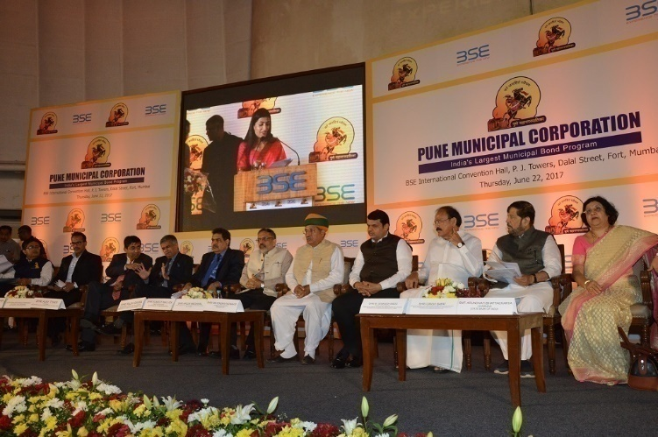

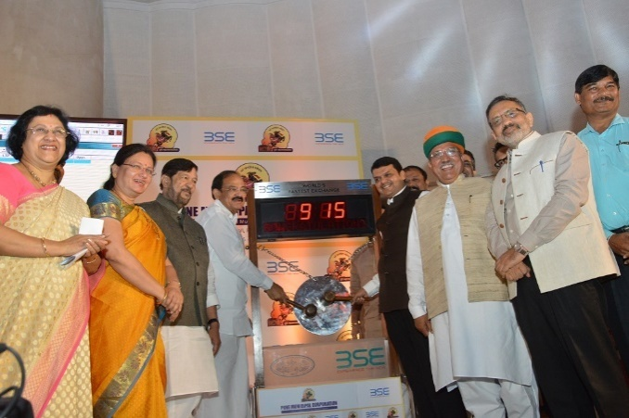
Snapshots - Listing on Stock Exchange

Slide 23
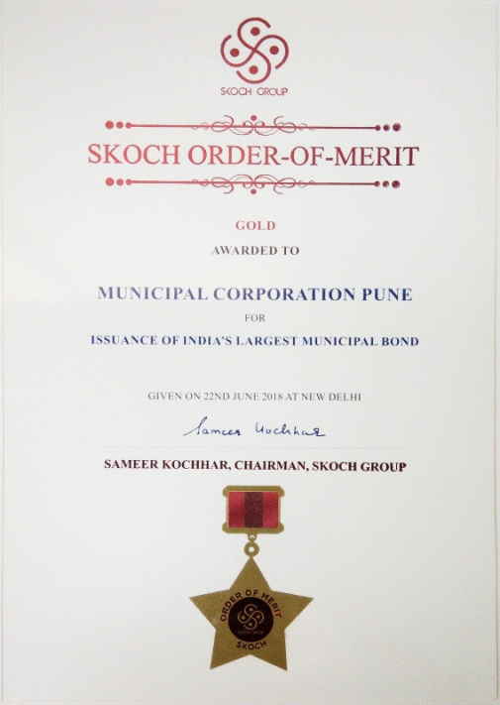
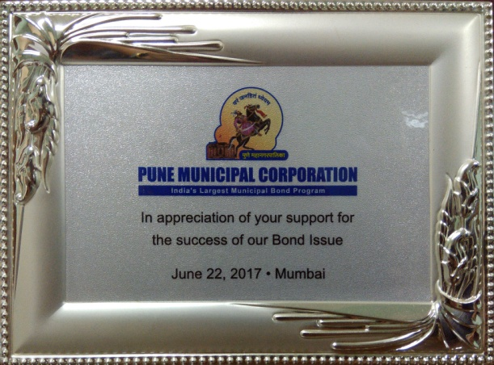
Rewards & Recognitions
Token of Appreciation to Honorary Members
Skoch Order of Merit “Gold” Award – June, 2018

Slide 24

Thanks!!!

