Slide 1
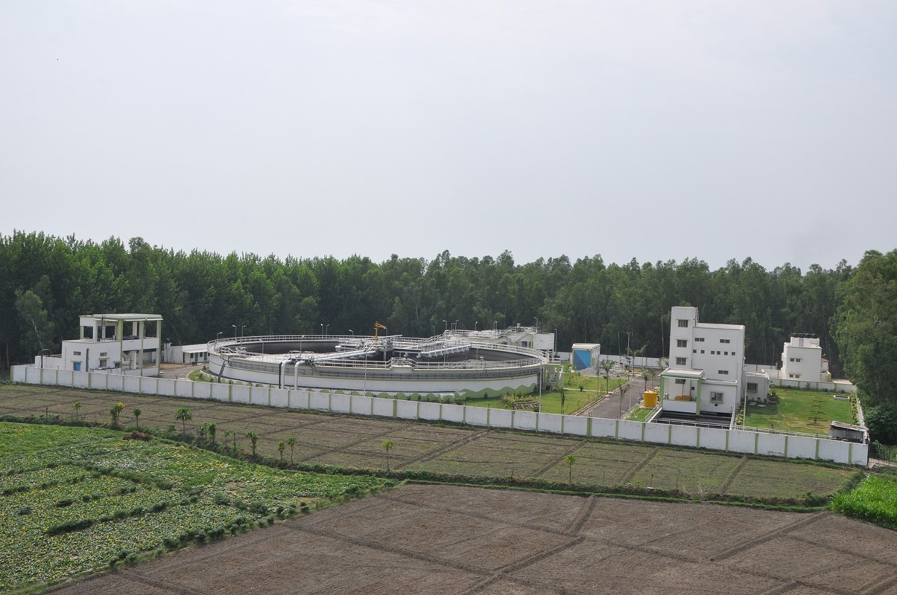
DEVELOPMENT OF SEWAGE TREATMENT PLANTS
UNDER THE HYBRID ANNUITY PPP MODEL

Slide 2
Efforts Towards Ganga Conservation
A Shift Towards Basin Based Approach
Namami Gange
Project under Separate Ministry for Ganga Rejuvenation
All 11 Basin states covered
Conservation measures for all tributaries of Ganga
GAP I
Launched in 1985
Focus on Main stem of River Ganga
25 Towns Covered
260 schemes completed
GAP II
Extended from GAP I in 1993
Merged with NRCP in 1996
Taken up works on four tributaries – Yamuna, Gomti, Damodar & Mahananda
NRCP
Launched in 1995
Covered 41 major Rivers of the country
8 Ganga basin rivers taken up viz Betwa, Chambal, Gang.a, Mahananda, Mandakini, Ramganga, Yamuna
NGRBA
Separate Authority for Ganga created in 2009
Chaired by Prime Minister of India
NMCG as an implementing body at center and SPMGs at states
GAP :Ganga Action Plan
NRCP :National River Conservation Plan
NGRBA :National Ganga River Basin Authority
NMCG :National Mission for Clean Ganga
SPMGs :State Program Management Groups
GAP Expenditure ₹ 961.04 crore
Total sewage treatment capacity created: 1078 MLD
Common Effluent Treatment Capacity Created: 20 MLD

Slide 3
Namami Gange
Wholesome River
Clean River
River Front Development
Capacity Building
Research and Monitoring
Awareness creation
Protection of flora and fauna
(a) Entry Level Activities
River surface cleaning
Modernization, renovation of Ghats
Modernization, renovation of Crematoria
Ghat Cleaning
b) Medium Term Activities
Municipal sewage management
New projects
Hybrid Annuity
Industrial effluent management
Water quality monitoring
Rural sanitation
(c) Long term Activities
Aqua life conservation
Afforestation
d) Other activities
MoU with Ministries
Public Outreach
Total outlay: Rs 20000 Cr.(Rs.7272 Cr Ongoing work + Rs.12728 Cr New Initiatives).
Notes:
4 ghats completed in Patna out of 12. the has increased the space for the community to connect with the river
Similar projects proposed in several other cities such as Kanpur, Kolkata, rishikesh, Sultanganj, etc.

Slide 4
Municipal Sewage Management in Towns along Ganga Main Stem
-17 %
+5%

Slide 5
Focus on Large Cities of Ganga Main Stem
10 towns with a total sewage generation of 1897 Mld contribute almost 64% of total sewage (2953 Mld) discharge from the 97 towns to river Ganga
All figures are in Mld

Slide 6
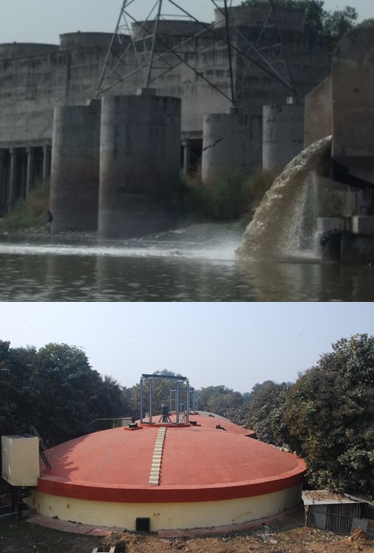
Why Hybrid Annuity
Traditional procurement models – EPC or DBOT – do not provide adequate safeguards for sustainable O&M of STPs
Several models studied to ensure sustainability and accountability
Hybrid Annuity model most practical for sectors with uncertain revenue stream
A procurement model to enhance accountability of the contractor & sustainability of infrastructure
In Jan. 2016, Government approved the Hybrid Annuity model for infrastructure projects under the Namami Gange program
6

Slide 7
Salient Features of the model
Different from pure annuity projects where the entire project cost is mobilized by the private company.
Budget support for payment for project development.
Participatory approach in development of tender documents. – NMCG has conducted 3 market conferences with bidders and a meeting with lenders.
Construction cost and O & M cost are index linked to cover inflation risk.
Payment security mechanism – Payments for two year annuity are placed in a separate escrow account.
Annuity payment and O & M costs are linked to the achievement of key performance indicators.
Project supervision by independent Project Engineers appointed by NMCG
Interest payment covered during O & M period.
Incentives built in for performance as well as energy efficiency

Slide 8
Payment Mechanism
Construction linked payments
Payable by commissioning, as certified by the Jal Nigam, aggregating 40% of the Project Cost quoted by the developer in its Financial Proposal
Quarterly Payments – Capex Annuities, O&M Charges and Reimbursements
Annuities
Reimbursements
Capex Annuity
O&M Charges
Power Charges
Capex annuity (EMI for balance 60% of the Bid Project Cost) paid out over 60 quarters of O&M Period + Interest on reducing balance of 60% of the Completion Cost
O&M Charge, as quoted by Developer in its Financial Proposal, subject to compliance with specifications & adjusted for penalties.
To be adjusted for inflation index
Paid on actuals to the Utility by the Concessionaire and reimbursed by NMCG subject to cap as per power units quoted in bid
8

Slide 9
Project Structure
NMCG
JAL NIGAM
Land and ROW
BANKERS /FIs
Escrow Account
PROJECT SPV
(Selected Bidder)
Term Loan/ WC
Design, build, finance, operate, maintain and transfer
Appointed by NMCG
Project Engineer
Sewage Treatment Infrastructure
Review and construction supervision, monitoring of KPIs
9

Slide 10
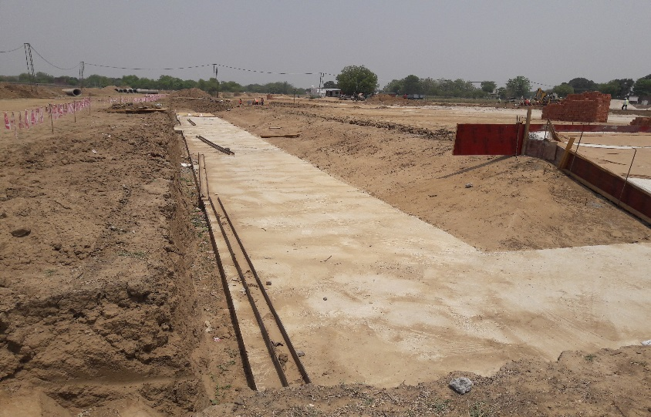
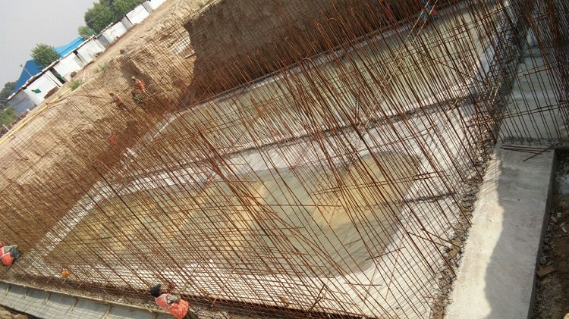
First Two Hybrid Annuity Projects
Varanasi
Uttar Pradesh Jal Nigam
50 MLD STP at Ramana
Rehabilitation of pumping station, rising main
Bund, boundary wall & effluent disposal pipeline
Haridwar
Uttarakhand Pey Jal Nigam
68 MLD STP at Jagjeetpur and 14 MLD STP at Sarai
Site fencing & internal roads
10

Slide 11
Outcome of the Bid Process
Varanasi
8 bids received:
Adani Enterprises
Essel Infraprojects
HNB Engineers
Metito Utilities
Panchdeep Constructions
Suez
VA Tech Wabag
Vishvaraj Environment
Haridwar
6 bids received:
Adani Enterprises
HNB Engineers
Metito Utilities
Shapoorji Pallonji
Suez
VA Tech Wabag
International Competitive Bid as per best practice
More than 700 pre bid queries were replied.
One of the most rapid PPP bid processes in a new sector
11

Slide 12
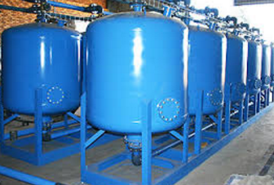
One City One Operator
Based on the successful outcome of the first two bids, NMCG has moved one step ahead towards the concept of One city –One operator under HAM.
Paradigm shift – Integration of existing sewage infrastructure with the development of new STPs.
Re Use of Water for ensuring sustainability of assets and resources.
Mathura Sewage Scheme
Development of 30 MLD STP
Rehabilitation of 3 existing STPs(37 MLD) & associated infrastructure
Development of 20 MLD TTP for supply of water to Mathura Refinery of IOCL.
IOCL to share full O & M cost and partial capital cost of TTP through water tariff
Bid Participants: Essel, Adanai,Triveni, VA Tech Wabagh
Work Awarded to Triveni Engineering Industries Limited at Rs 437.95 Cr.
12

Slide 13
HAM PROJECTS
Sr. No. | State / Project Description | STP Capacity in MLD |  |  | Cost (in Rs. Cr.) | Status
 |  | Existing | New | Total
1 | Haridwar |  | 82 | 82 | 171.53 | Awarded
2 | Varanasi |  | 50 | 50 | 153.16 | Awarded
3 | Mathura | 37.3 | 30 | 67.3 | 437.95 | Awarded
4 | Allahabad | 254 | 72 | 326 | 1671.60 | 6 Bids received
5 | Kanpur | 425 | 50 | 475 | 102.19 | 6 Bids received
6 | Mirzapur and Ghazipur | 14 | 18 | 32 | 114.92 | Bids received
 |  |  | 21 | 21 | 90.81
7 | Farrukhabad | 2.7 | 35 | 37.7 | 213.62 | 2 bids received
8 | Patna |  | 150 | 150 | 1402.89 | Under Tender
9 | Bhagalpur |  | 65 | 65 | 254.13 | To be tendered
10 | Tolly' Nullah - KMC ( Kolkata) | 107 | 26 | 133 | 472.28 | Under Tendering
11 | Howrah - KMDA | 22 | 165 | 187 | 522.25 | Under Tendering
12 | Maheshthala (KMDA) | 4.2 | 26 | 30.2 | 198.43 | To be tendered
13 | Hoogly Chinsura |  | 29.3 | 29.3 | 160 | To be tendered
 | TOTAL | 866 | 819 | 1686 | 5965.76

Slide 14
Thank You

