Slide 1

AMRUT
Innovations in Sewerage & Septage Management in Rajasthan

Slide 2
Sewerage Sector- Overview and Challenges
Overview:
29 Mission towns ; 90 Projects ; Total budget Rs. 3223.94 Crs.
56 projects Sewerage & Water Supply; 96% budget- Rs. 3115.11 Cr.
33 Projects of Sewerage; Rs. 2107 Cr. (65%).
Total household - 20,20,965
At start of Mission - 5,88,818 (29%).
Coverage during Mission - 5,22,728 (26%)- (15% through AMRUT + 11% through other projects)
GAP - 9,09,419 (45%)
Cont..

Slide 3
Sewerage Sector- Overview and Challenges
Challenges:
Shortage of Experienced Constructing Agencies
Poor perception about sewerage works.
Duration of construction is more.
Lot of inconvenience during construction especially delay in restoration of roads.
Delays in House hold sewer connection.
Public Acceptance is less
Already have septic tank or some arrangements.
Lack of awareness
Construction difficulties
Delays in transfer of benefit due to complicated procedure.

Slide 4
Innovative Measures – Bid Document
Cluster Approach- All Sewer related activities of the town including sewer network construction of STP, SPS, House Sewer Connection, Road Restoration and 10 year O &M were included in a single package. Cluster approach was adopted by clubbing sewerage works of geographically related towns to attract good Constructing Agencies. 15 AMRUT towns of Rajasthan were divided into 5 packages, each package cost in the range of Rs. 300 to 400 Cr.
Impact:
Good Constructing Agencies like L&T and Tata participated and now executing the works in Rajasthan.
Cont..

Slide 5
Innovative Measures – Bid Document
O&M for 10 years- Operation & Maintenance of 10 years is part of the scope of works of Contractor.
House Sewer Connection- Inclusion of House Sewer Connections to provide end to end solutions and to make assets functional.
Performance based Contract – Linked with timely restoration and House sewer connections (40% on supply; 30% on road restoration and 30% after commissioning)
Reuse of Treated Waste Water- To encourage reuse, Over Head Tank of 22 m staging is constructed included to cover large command area for Irrigation, Industries, landscape, tail end users.

Slide 6
Innovative Measures – Bid Document
Innovative Evaluation Criteria
Allowance for non-conventional energy source for operation of STP
A condition was included in the bid document for the bidders that additional allowance shall be given @ double the cost of power consumption, who guarantees use of non-conventional energy measure like solar in place of electricity.
The selection was based on the least cost after analysing: “ Capital Cost + 10 years O & M cost + cost of Power Consumption – 2 x cost of Power Generation by non-conventional energy”.
Impact-
Containment of project cost
Reduction in O&M cost
Ensures Sustainability
Cont..

Slide 7
Innovative Measures – Bid Document
Comparison of Power requirement and Generation by Solar Energy
S. N. | Name of ULB | Power requirement at STP (in KW) | Power generated by Solar at STP (in KW) | % coverage by Solar for Power requirement at STP | Excess Power Generated (in KW)
1 | Beawar | 5198.47 | 1032.55 | 20%
2 | Kishangarh | 960.00 | 300.00 | 31%
3 | Ajmer | 5520.00 | 1200.00 | 22%
4 | Churu | 3687.42 | 5812.00 | 158% | 2124
5 | Nagaur | 1770.70 | 2356.00 | 133% | 585
6 | Sujangarh | 4761.70 | 2202.00 | 46%
7 | Baran | 2853.00 | 361.00 | 13%
8 | Bundi | 602.00 | 110.00 | 18%
9 | Chittorgarh | 4776.39 | 418.40 | 9%
10 | Bharatpur | 2021.29 | 202.82 | 10%
11 | Gangapur City | 5447.04 | 682.13 | 13%
12 | Hindaun | 4595.25 | 493.69 | 11%
13 | Sikar | 3648.39 | 428.44 | 12%
14 | Bhiwadi | 5620.50 | 826.68 | 15%
Total |  | 51462.15 | 16425.71 | 32%

Slide 8
Innovative Measures – Bid Document
Hybrid Annuity Model(HAM)
Concession period as well as payment period is kept as 15 years.
Project cost is shared with Government and Private Company in ratio of 40:60 respectively.
40% of State’s share is released after commissioning of the project & remaining 60% in form of fixed annuity.
40% of total payment is to be made after completion of the Sewage Treatment Plant. The remaining 60%, which includes operation and maintenance costs and the assured profits, to come in the form of fixed annuities.
The concessionaire is selected through competitive process based on Rajasthan Transparency in Public Procurement (RTPP) Act.
3 STPs of with total capacity of 40 MLD are being executed under HAM model in Udaipur, Rajasthan.
Cont..

Slide 9
Innovative Measures – Bid Document
Impact of Hybrid Annuity Model(HAM)
Saving of 60% value in Capital Investment(48 Cr saving in a project of 80 Cr cost).
As the concession period is 15 years, therefore, O&M period also is 15 years.
Assured O&M because the 60% Govt. share shall be released during O&M period.
PPP operator is motivated to reuse the treated effluent as he is the owner of effluent and in order to recover the cost /earned profit, is inclined to reuse the effluent.
Cont..

Slide 10
Innovative Design & Construction Methodology
Sewerage Projects are designed on de-centralized STP and associated network which will ensure following advantages:
Each zone will have separate sewerage system. The commissioning of zone will not be affected by the delays of STP’s of other zones.
Beneficiaries of zone will start getting benefit of sewerage system immediately after commissioning of sewerage system of the zone.
The depth of manhole and Sewer system will be reduced substantially as compare to Centralized system. This will ensure minimum public inconvenience and to transfer immediate benefits to the citizen.
Construction of Earth Quake resistant structure

Slide 11
Innovative Design & Construction Methodology
Public Friendly Construction Methodology - Initially the Contractor is allowed to start the work of STP and Outfall /main sewer. Only after completion of 80% of outfall works, lateral work shall be allowed as per the work plan.
STP >> Outfall >> Main >> Lateral >> House Sewer Connection
Impacts:
Immediate functioning of Sewerage System.
Immediate transfer of benefits.
Least public inconvenience.

Slide 12
Use of latest Technology
SBR (Sequential Batch Reactor) based STPs for achieving effluent parameters i.e. BOD<10 ppm; COD<50 ppm; TSS<10 ppm; NH4-N<5 ppm; N<10 ppm and Fecal Caliform<100 MPN/100ml.
Fully Automatic, mechanised with provision of SCADA (Supervisory Control & Data Acquisition) along with PLC (Programmable Logic Controller) and Laboratory.
SCADA- a control system architecture that uses computers, networked data communications and graphical user interfaces for high-level process supervisory management.
Online monitoring of effluent parameters.

Slide 13
Use of latest Material
Use of DWC(Double Wall Corrugated ) pipes - 90% DWC pipes are used to enable ease of handling, quick laying & jointing and controlling in pipe leakage.
Use of Pre-cast Manholes to expedite & ease of construction.
PVC-U pipes, which are flexible and non-corrosive are used for House Sewer connections .
Use of Sulphate Resistant Cement in Sewage retaining structures & RCC pipes to increase life of Sewerage System.

Slide 14
Smart Solutions
Use of VFD(Variable Frequency Drive) to ensure power efficiency of equipment.
Ultrasonic Level sensor integrated with GSM technology based Alarm system in critical Manholes to avoid overflow and chocking
Use of trenchless technology to minimize public inconvenience and loss of property & human life:
Railway/NH and other crossings
Narrow lanes with high rise buildings
Critical locations
Reuse of Treated Waste Water- To encourage reuse, Over Head Tank of 22 m staging is constructed included to cover large command area for Irrigation, Industries, landscape, tail end users.

Slide 15
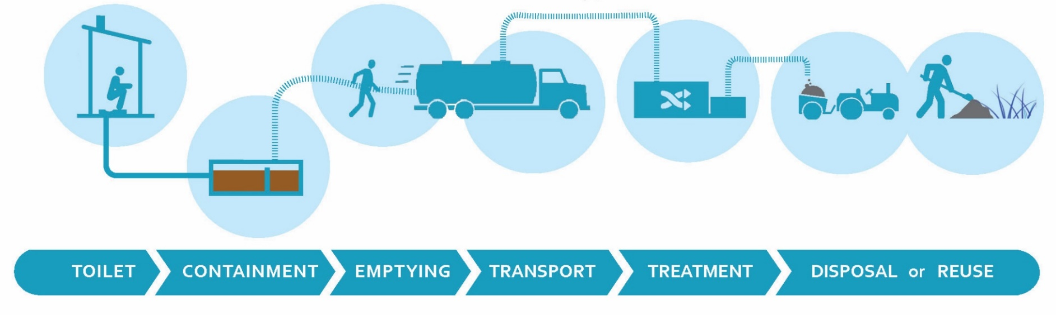
Septage Management
FSSM is Low cost affordable sanitation solution because of requirement of low capital investment, less O & M expenditure and high resource recovery.
Process of safe Collection, Conveyance, Treatment and Disposal/ Reuse of Faecal sludge and septage from onsite containment such as pit latrines, septic tanks, etc.
Management of the faecal waste which is not conveyed by Sewerage System.

Slide 16
Septage Management
Prepared State Sewerage and Waste Water Policy in Year 2016 with a target of covering major towns in 5 years, towns having population greater than 50,000 and less than 1,00,000 in 10 year and all remaining towns in 15 Years.
80 towns out of 190 towns are being covered by Sewerage system. About 100 towns will be covered by FSSM (Faecal Sludge & Septage Management).
Guideline prepared for implementation of FSSM and situation analysis of 100 smaller towns with the support of NIUA are being done.
Identified eligible towns for pilot initiatives and started full scale FSSM solution in three towns (Sambhar- Phulera, Khandela & Lalsot) in Rajasthan

Slide 17
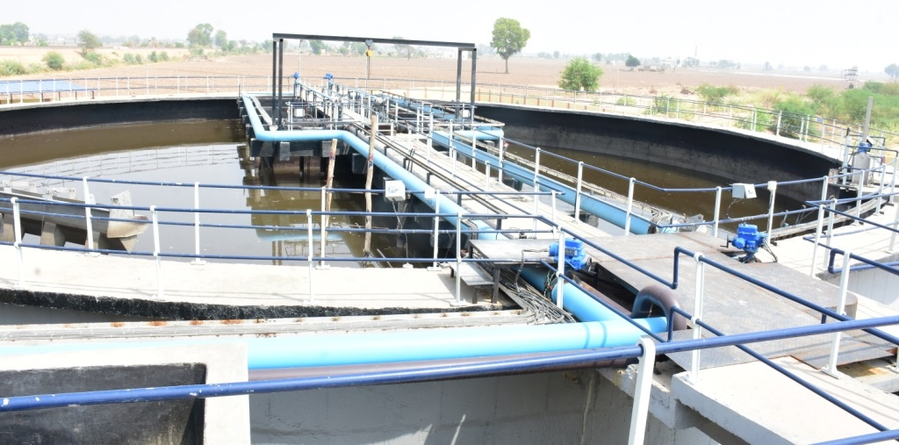
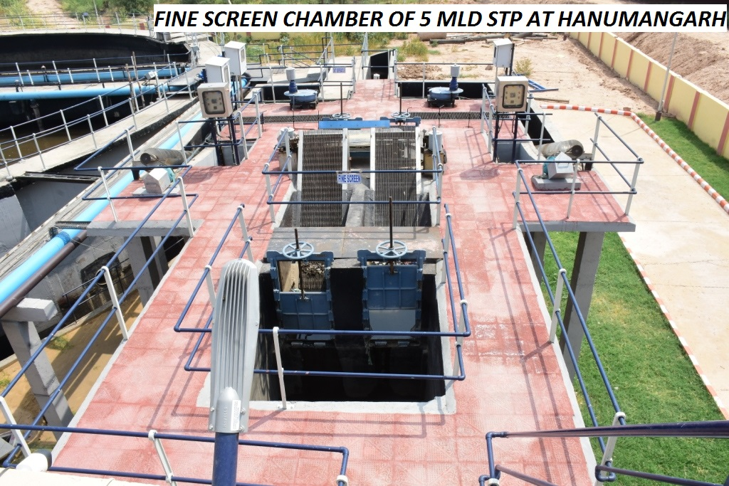
Glimpses of Completed Project- Sewerage
5 MLD STP Completed at
Hanumangarh

Slide 18
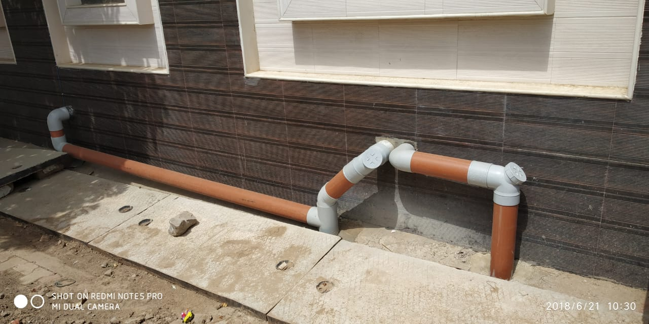
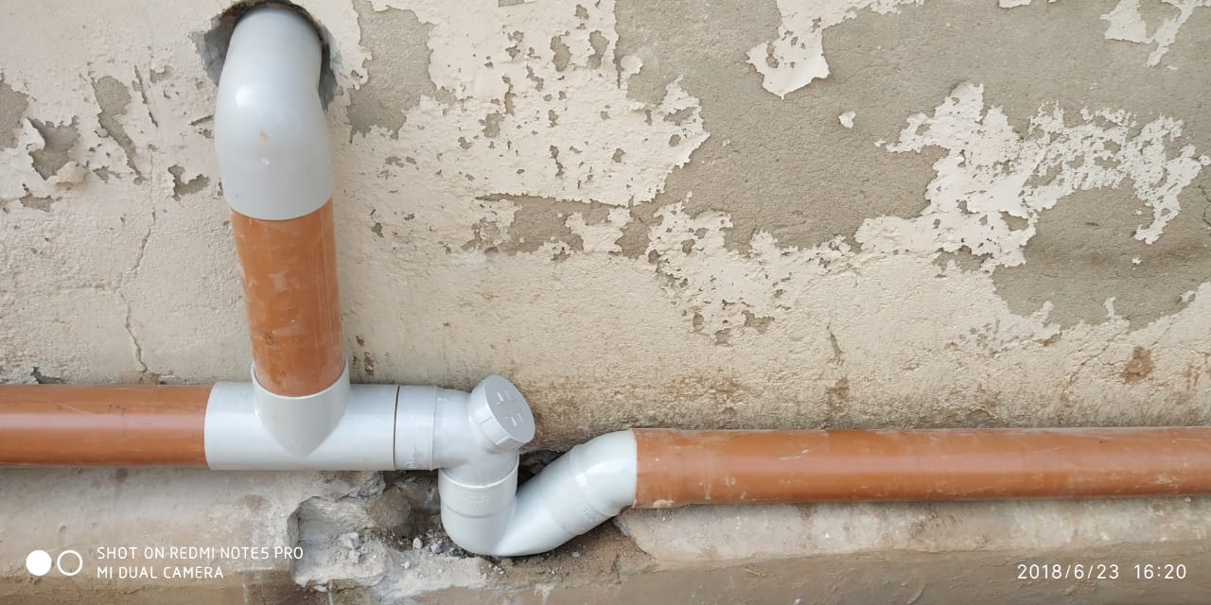
Glimpses of Ongoing Projects- Sewerage
House Sewer Connections at Alwar

Slide 19
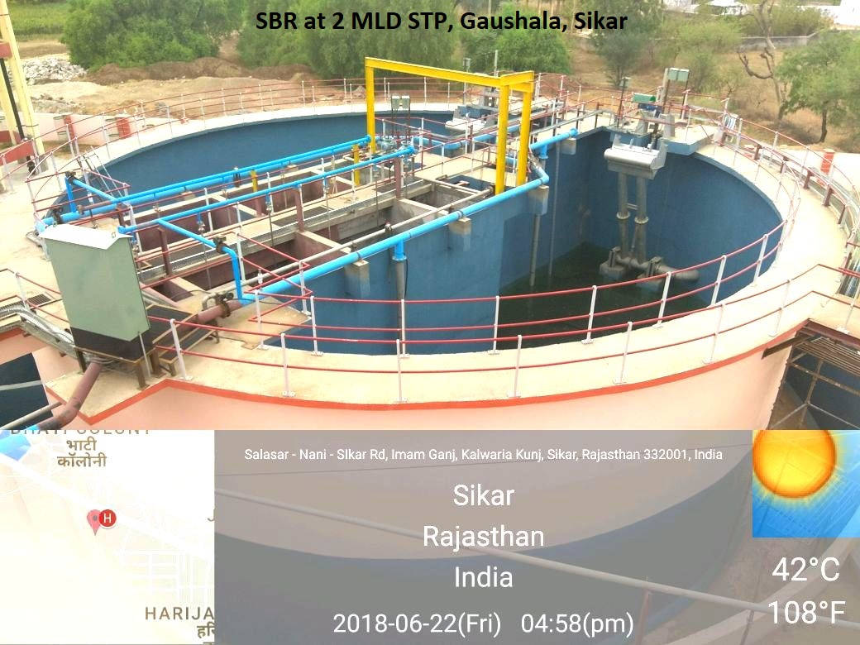
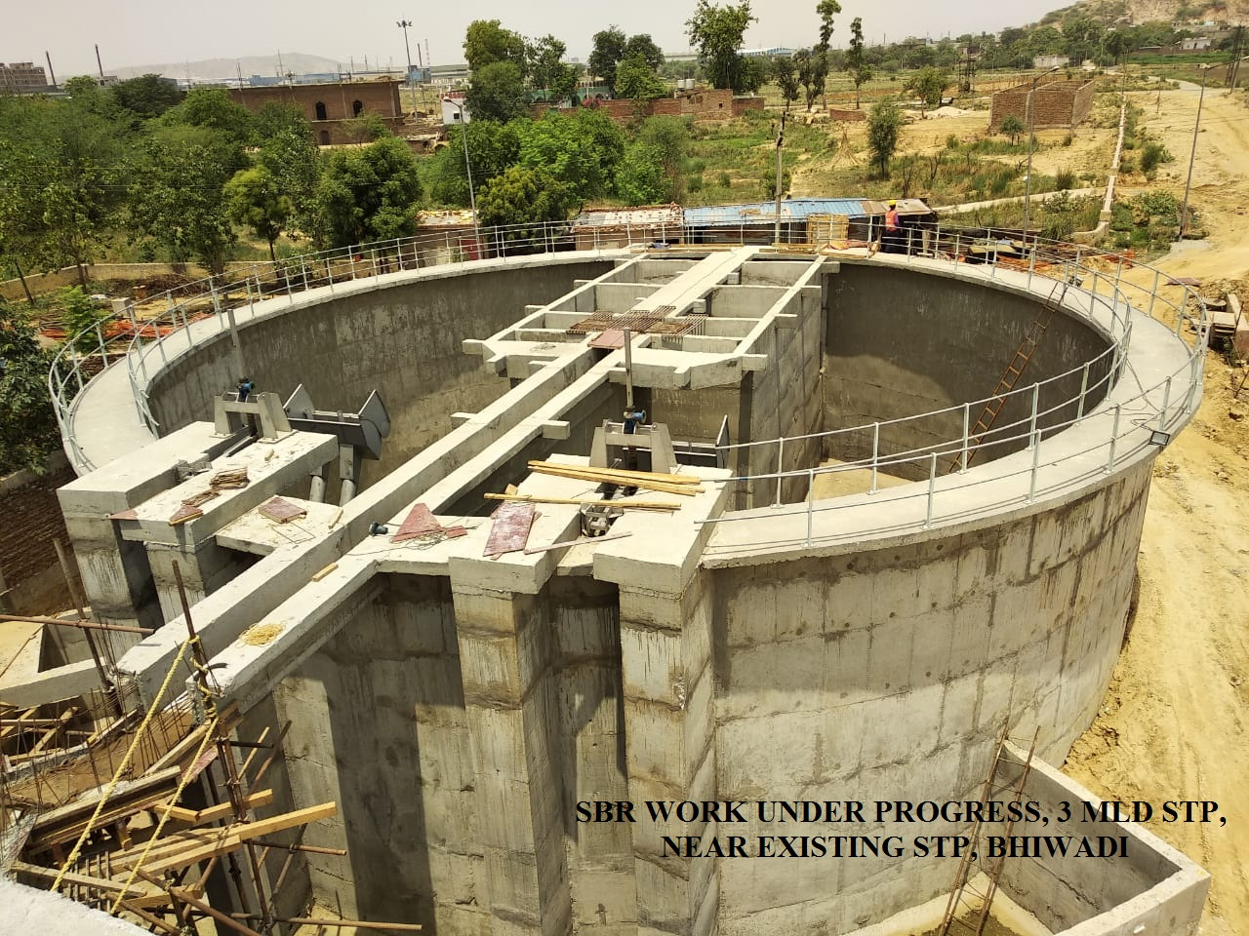
Glimpses of Ongoing Projects- Sewerage
2 MLD STP at Sikar
3 MLD STP at Bhiwadi

Slide 20
THANKS

