Slide 1

STREET LIGHT NATIONAL PROGRAM (SLNP)
&
MUNICIPAL ENERGY EFFICIENCY PROGRAM (MEEP)
Creating an Energy Efficient India
27th July 2018
Ministry of Housing & Urban Affairs

Slide 2
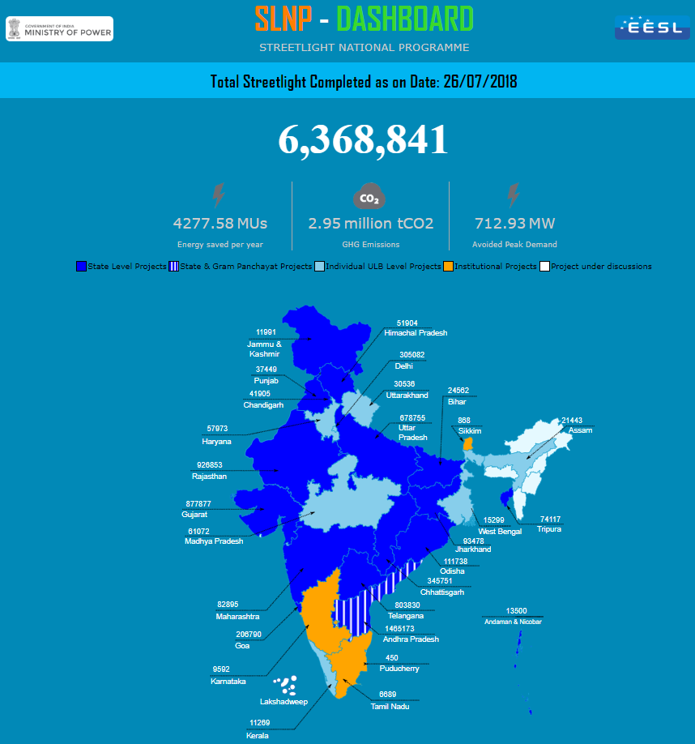
SLNP (Street Light National Program) (slnp.eeslindia.org)
Launched by Hon’ble Prime Minister on 5th January, 2015 to replace the approx. 1.34 crore numbers of conventional street lights with smart and energy efficient LED street lights ( as on 26th July 2018)

Slide 3
SLNP Status
PAN INDIA Status
Total No. of ULBs enrolled= 941,
No. of ULBs where work completed= 506,
No. of ULBs where work is under progress= 109.
Total No of Streetlight replaced – 63.54 Lakh .
AMRUT Cities
Agreement signed with 175 AMRUT cities (24 States/UTs) out of 500 AMRUT cities for LED street light project implementation.
Total number of LED Lights installed in AMRUT cities = 34,00,842 (53.51 % of the Installations done in AMRUT cities out of 63.54 Lakhs no’s completed across PAN-India)

Slide 4
SLNP Status in Uttar Pradesh
SLNP-UP
Total Agreement signed = 29
No. of ULBs where work completed= 17,
No. of ULBs where work is under progress= 12.
Total No of Streetlight replaced – 5.84 Lakh .
AMRUT Cities (UP)
Agreement signed with 25 AMRUT cities out of 61 AMRUT cities for LED street light project implementation.
Total number of LED Lights installed in AMRUT cities = 5,39,565 (92.3 % of the Installations done in AMRUT cities out of 5.84 Lakhs no’s completed across UP)

Slide 5
Benefits of SLNP (as on 23.07.2018)
Average Energy Saving per Year – 4277.58 MUs
GHG Emission Reduction per year – 2.95 Million tCO₂
Avoided Peak Demand – 712.93 MW
Support required
Payment Mechanism to be developed with the support of MoH&UA leading to timely release of payments to EESL.
Support required from MoH&UA to start projects in new states (Karnataka, Tamil Nadu, Madhya Pradesh & West Bengal etc.)

Slide 6

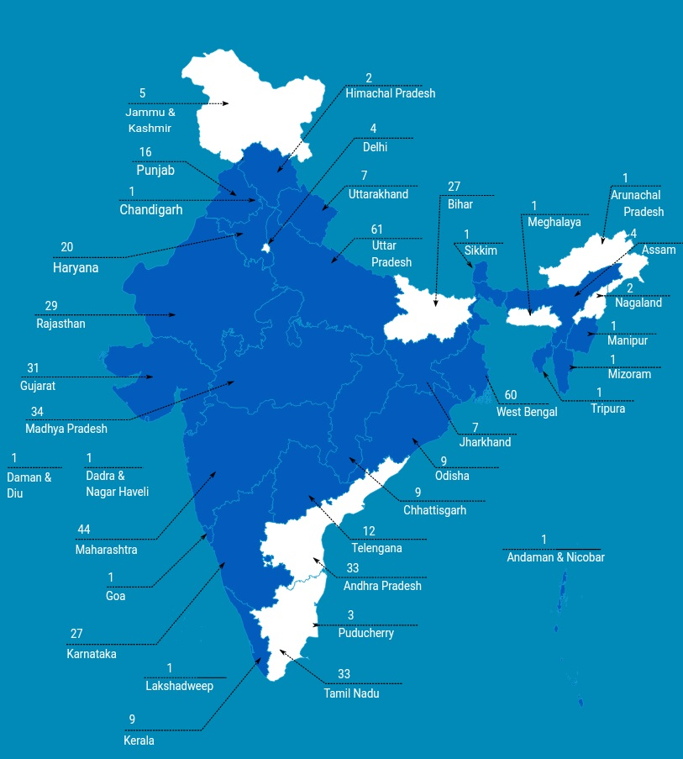
Municipal Energy Efficiency Program
40% to 60% of Energy Cost arise from Supplying water
4800 Million units of electricity is wasted every year due to inefficient water pumps
Under AMRUT, EESL with MoH&UA to implement retrofits of energy efficient pumps across 500 SMART cities

Slide 7
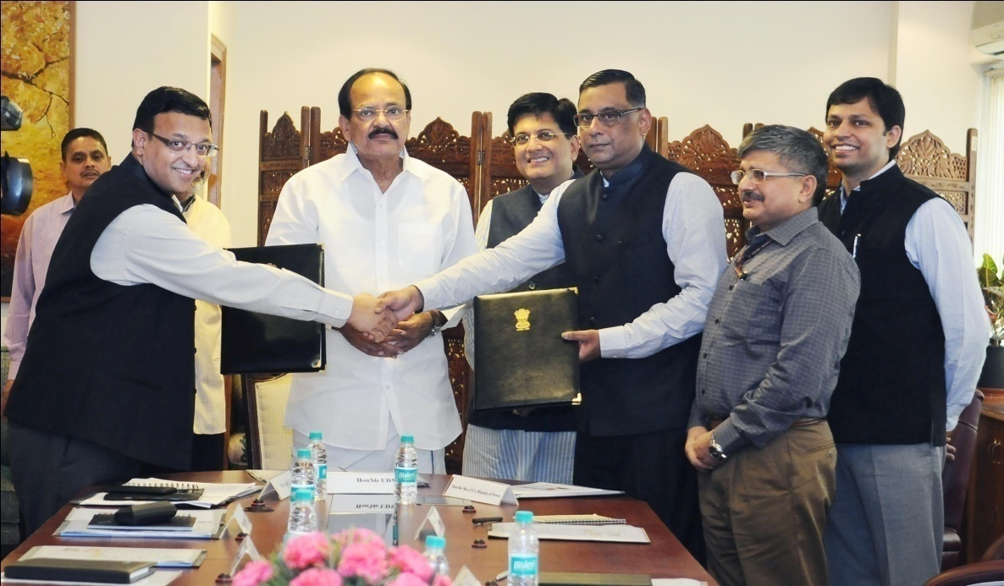
Municipal Energy Efficiency Program Current Status
Particulars | Status
Number of states/UTs which have signed the agreement | 25
Number of cities for which the agreement is signed | 390
The overall status of IGEA report preparation for 390 cities is as follows:
  Number of Cities for which LoAs issued : 310
  Number of IGEA reports submitted to the ULBs/State Government : 202
310 ULBs have been covered under the Investment Grade Energy Audits across 14 States.
4 States/UT (Assam, Chandigarh, Chhattisgarh, Jharkhand & Odisha) having 30 AMRUT Cities have given approval for submitted IGEA Report.
The total number of pump-sets identified based on the Energy Audit to be replaced across 202 ULBs is 7076.
Total investment identified towards replacement of pump sets, repair and maintenance for 7 years across 202 ULBs is INR 280 Cr.

Slide 8
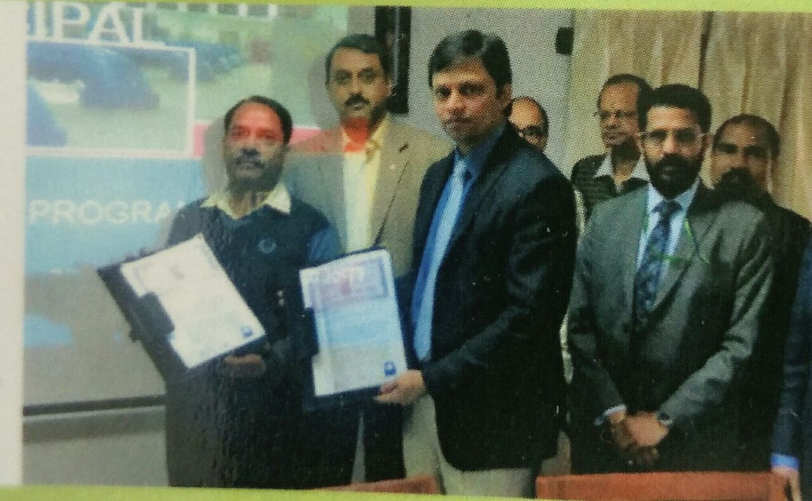
MEEP Agreement with Uttar Pradesh
EESL and “Directorate of Urban Local bodies – State Mission Director (AMRUT),” Govt. of Uttar Pradesh have jointly entered into an agreement on 9th February, 2017.
Status of IGEA Report under AMRUT – Uttar Pradesh:
Total No. of AMRUT MISSION Cities in UP | No’s | 61
No. of Inventory Received for IGEA Reports | No’s | 61
LoA Issued for Energy Audit and Preparation of IGEA Reports | No’s | 61
Kick-off Meeting Held with ULBs | No’s | 61
Energy Audit Completed | No’s | 61
IGEA Reports Finalized and Submitted* | No’s | 60
IGEA Report under Preparation* | No’s | 1
Note: IGEA for Lucknow is under preparation.

Slide 9
Overall Status of 60 Nos. of IGEA Reports- Uttar Pradesh
Pump sets as per inventory (LOA) | No’s | 4,004
Pump sets under maintenance/defunct/ condemned/un-available/un-auditable/list issue | No’s | 1,043
Pump sets audited | No’s | 2,961
Pumps sets considered for replacement | No’s | 2,124
Reasons for pumps not recommended for replacement –837 nos.
Pumps are operating at better efficiency and/or payback period was more than 84, few are already considered under replacement and few cases are cases of bore failure

Slide 10
Summary of Uttar Pradesh (for 60 ULBs)
Details | Unit | Value
Pump set as per inventory (LOA) | Nos. | 4,004
Pump sets under maintenance/ defunct/ condemned/ un-auditable/list issue/abandoned | Nos. | 1,043
Pump set covered in energy audit | Nos. | 2,961
Pump set recommended for replacement | Nos. | 2,124
Present annual energy consumption | MUs* | 250
Annual energy consumption with proposed EEPS | MUs | 150
Annual energy saving potential | MUs | 100
Percentage energy savings | % | 40
Total project cost | Rs. Lakhs | 6,590
Monetary savings per annum | Rs. Lakhs | 7,548
Simple payback period | Months | 10
Percentage of savings with ULB after annuity payment to EESL | % | 67

Slide 11
Strategy for Implementation of MEEP in Uttar Pradesh
Official approval from SLTC, Uttar Pradesh on the IGEA report
Signing of Implementation Agreement
Selection of suppliers/ vendors
Project Implementation
Activity | Months
 | 0 |  | 1 |  | 2 |  | 3 |  | 4 |  | 5 |  | 6 |  | 7 |  | 8 |  | 9
Signing of Implementation Agreement
Inviting tenders for selection of pump supplier
Selection of pump supplier
Installation of energy efficient pump sets at ULB
Submission of M & V report to ULB by EESL

Slide 12
Energy Savings
EESL will provide a guaranteed 20% energy savings at ULB level
M&V Protocol
Measurement of parameters pre - implementation (before installation of EEPS) using energy auditing instruments
Measurement of parameters post - implementation using energy auditing instruments.
Energy savings are calculated as the difference in power drawn (in pre and post implementation scenario) multiplied by the operating hours mentioned in IGEA report.

Slide 13
Salient Features of Implementation Agreement
Parties to the agreement:
  State Government Department – Payment Security
  Urban Local Body - Beneficiary and Annuity payment to EESL
  EESL – Procurement, Replacement and Maintenance i.e. Implementing Agency
Scope includes:
  Procurement of Energy Efficient Pump Sets (EEPS)
  Dismantle of existing old pump sets and handover to ULB on as-is where-is basis
  Installation of EEPS and other related components with allied civil work
  Measurement and Verification
  Repair & Maintenance (R&M) of the EEPS for a period of 7 years

Slide 14
Duties, Responsibilities and Obligations of the Parties
State Government | EESL | ULB
Support to get approval from concerned departments/ agencies | IGEA report preparation | Active and full support to EESL while implementation for necessary approval, direction to concerned staffs, etc.
Provide payment security | Procurement, installation and commissioning of the EEPS, dismantling of old pump sets and handover to the ULB | Provide access to EESL and/or Identified Supplier(s) to work in ULB premises/ offices/ pump houses/ plants/ overhead tanks/ sumps/ reservoir, etc.
Assist in settling disputes raised by local consumers, political parties, agencies, etc. | Measurement and Verification (pre-post measurement) | Operate the installed EEPS in accordance with good engineering practices
 | Repair & Maintenance (R&M) of the EEPS for a period of 7 years | Provide covered and enclosed space to set up godown (s) for storage of EEPS and its spare parts at free of cost
 | Training manuals | Annuity payments to EESL
 |  | Provide necessary safety and security of the EEPS and related components

Slide 15
Financial Assumptions in the Agreement and IGEA
Replacement of inefficient pumps in Public Water Works & Sewerage Systems would be at no upfront cost to the ULB’s.
The investment will be recovered from savings in energy costs (annuity on cost plus ROE basis).
KEY COST COMPONENTS AND ASSUMPTIONS
Project Implementation Cost
Tendered cost of preparation of DPR + 15% EESL service charge
Tendered Implementation Capital Cost for key components
Cost of dismantling & commissioning
Capitalized interest during Project Implementation Period Project establishment and supervision charges @ 5% of total implementation project cost
Recurring (Operational) Annual Expenses
Project Establishment and Supervision charges at 4% of the Project Implementation Cost
Financing Terms
Debt Equity ratio shall be 70 : 30;
Post tax return on Equity (ROE) at 16%, on the equity component of the Capital Cost
Interest Rate on the Debt component of the Capital Cost, at actuals;
Annuity repayment period i.e. Project Period shall be 7 years
Payments shall be made on a quarterly basis
Tendered Repair and Maintenance Charges

Slide 16
Support required:
Overall Benefits of MEEP
Annual Savings of approx. INR 3200 Crs for Pan India
Reduction of 3.9 Million tonnes in Carbon Emissions
Real time dashboard tracking
Easy monitoring of pumps & pump houses
Approval by State Level Technical Committee
Signing of Model Tri-partite Agreement with State/Urban Local Bodies

Slide 17
Thank You

